Slide 1

Home Depot Product Search Relevance
Vikas Srikanth
Gowri Dath
Sindhu BM
Mitali Bharali
Aditi Prakash

Slide 2
OBJECTIVE
Relevance is a number between 1 (not relevant) to 3 (highly relevant).
For example, a search for "AA battery" would be considered highly relevant to a pack of size AA batteries (relevance = 3), mildly relevant to a cordless drill battery (relevance = 2), and not relevant to a snow shovel (relevance = 1).
To predict a relevance score for the provided combinations of search terms and products

Slide 3
About this project
Dataset consisted of:
train.csv (74.1k x 5) - the training set, contains products, searches, and relevance scores
test.csv (167k x 4) - the test set, contains products and searches. We are predicting the relevance score for these pairs
product_descriptions.csv (124k x 2) - contains a text description of each product. We merged this table to the test set via the product_uid
attributes.csv (2.04m x 3) - provides extended information about a subset of the products (typically representing detailed technical specifications)
sample_submission.csv (167k x 2) - a file showing the correct submission format
relevance_instructions.docx - the instructions provided to human raters

Slide 4
About the dataset
Training set
53489 products
11795 search query
54667 product_uid
Testing set
94731 products
22427 search query
97460 product_uid

Slide 5
STRATEGY/WORKFLOW

Slide 6
Work Flow
Exploratory Data Analysis
Initial Data Visualization
Data Cleaning
Create Numeric Features (count, ratio, length)
Feature + Distance Measures
Multiple Linear Regression
Random Forests
Naïve Bayes

Slide 7
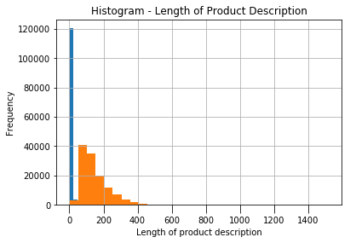
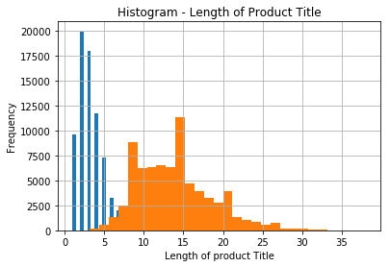
Exploratory Data Analysis
Histogram 1: Length of Product Description
Blue bars represent the frequency of digits
Orange bars represent the frequency of alphabets
Histogram 2: Length of Product Title
Blue bars represent the frequency of digits
Orange bars represent the frequency of alphabets

Slide 8
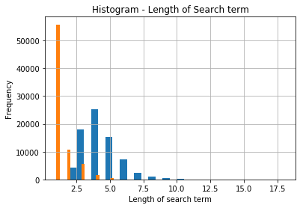
Exploratory Data Analysis

Slide 9
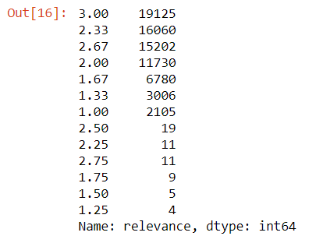
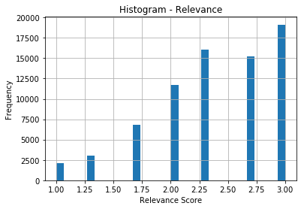
Exploratory Data Analysis

Slide 10
TEXT CLEANING

Slide 11
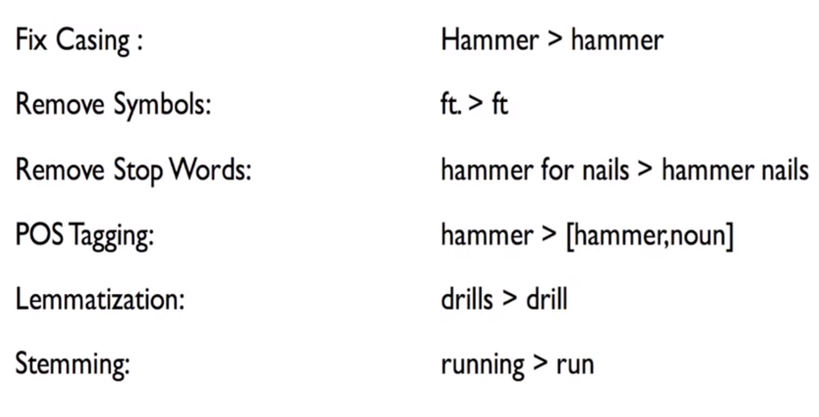
Basics

Slide 12
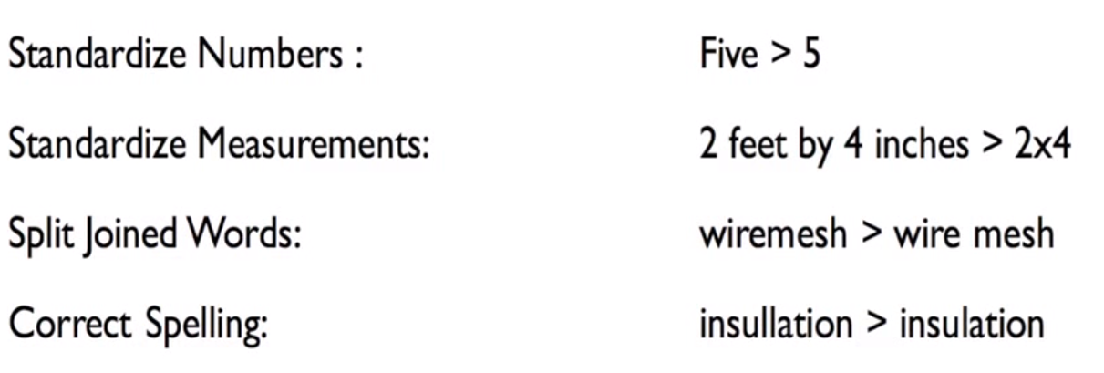
Advanced

Slide 13
Feature Engineering
1) Create num columns based on text columns
Count number of words from search query which appears both in product_title and product_description
Compute Edit Distance from search query which appears both in product_title and product_title
Compute the Cosine Similarity between search query, product_title and product_description
Compute the Jaccard Similarity between search query, product_title and product_description
Count number of words in the product description
Create new columns for each pair
2) Remove all text columns
As a result we will have vectors of numbers that suites well for the machine learning.

Slide 14
Distance Measures
EDIT DISTANCE:
The distance between the source string and the target string is the minimum number of edit operations (deletions, insertions, or substitutions) required to transform the source into the target.
COSINE DISTANCE:
Cosine similarity calculates similarity by measuring the cosine of angle between two vectors. With cosine similarity, we need to convert sentences into vectors.
JACCARD DISTANCE:
Jaccard Distance is a measure of how dissimilar two sets are. Lower the distance, more similar are the two strings.

Slide 15
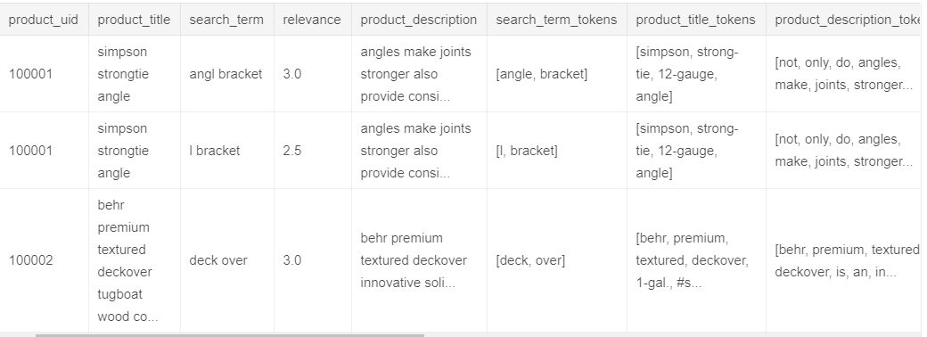
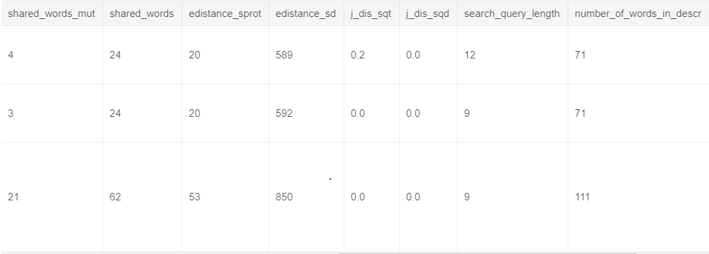
Feature Creation

Slide 16
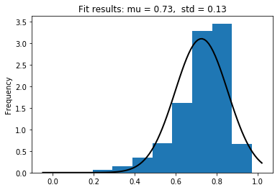
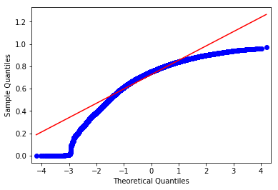
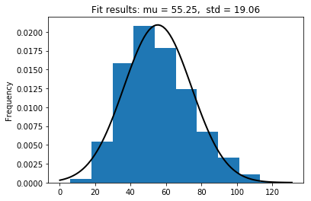
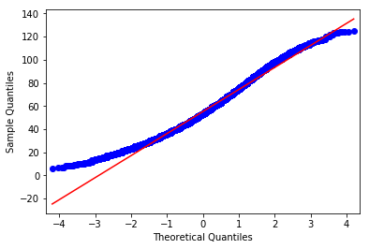
Features Analysis
Histogram of Cosine Distance
qqplot of Cosine distance
Histogram of Shared Words
qqplot of Shared Words

Slide 17
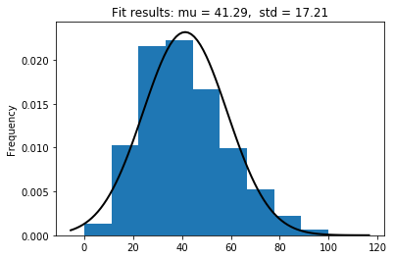
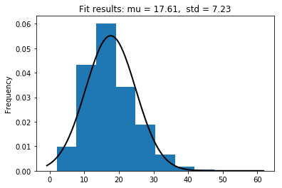
Training Features Analysis
Histogram of Edit Distance (Search term, Product Title)
Histogram of Search Query Length

Slide 18
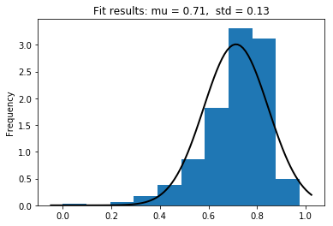
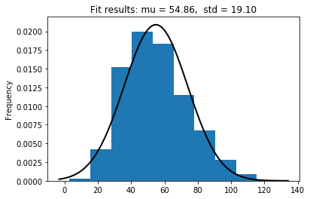
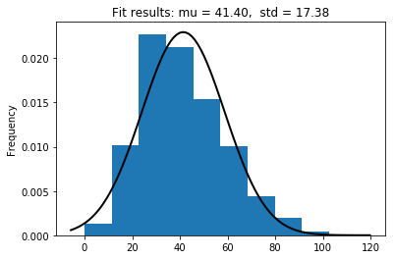
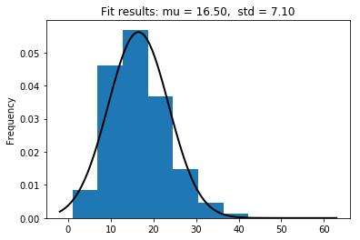
Testing Features Analysis
Histogram of Cosine distance
Histogram of Shared words
Histogram of Edit Distance (Search Term Vs Product Title)
Histogram of Search query

Slide 19
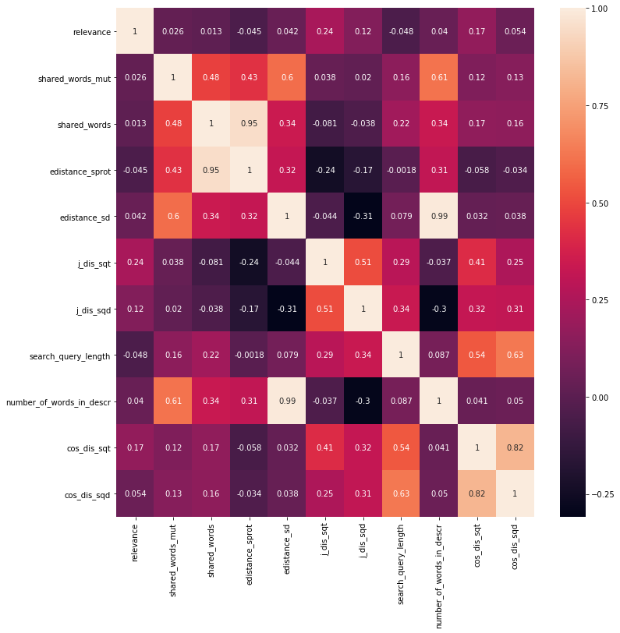
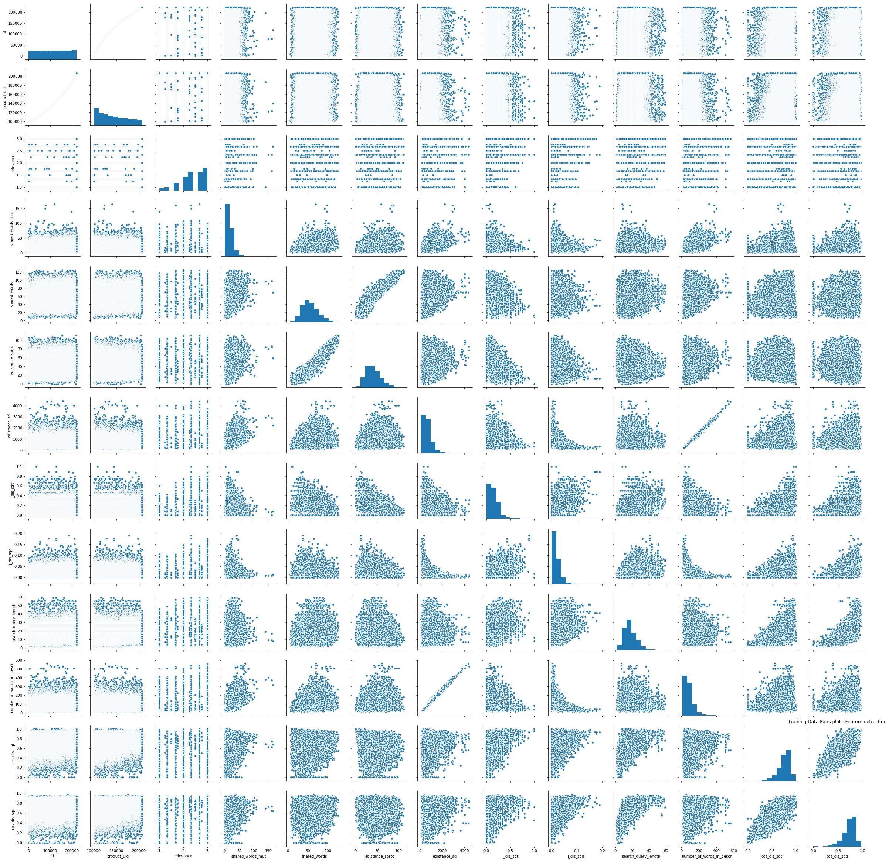
Training set – Heat map

Slide 20
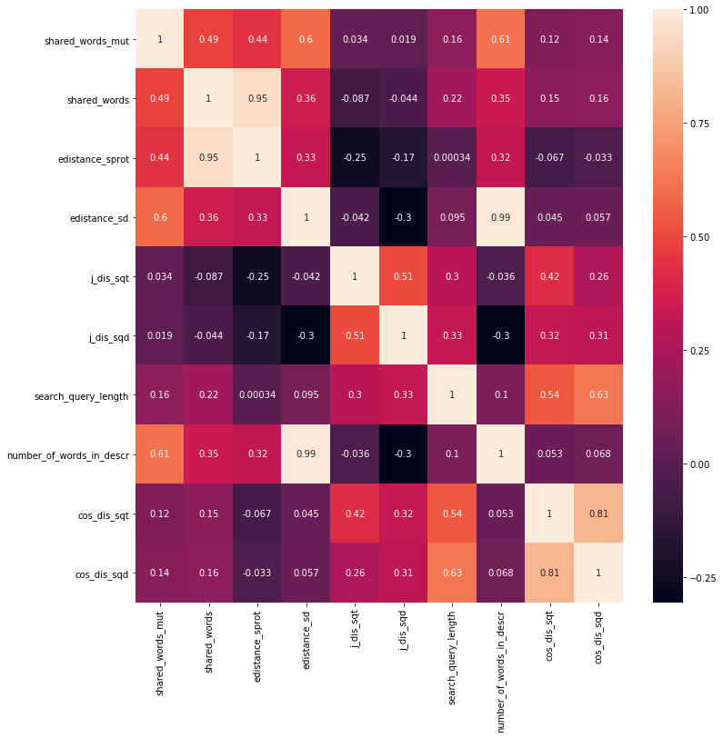
Testing Set – Heat map

Slide 21
MODELS USED
The best regressor predicts the relevance score for the Kaggle’s test data with minimum prediction error.
Comparing the mean RMSE :
Algorithm | RMSE
Linear Regression | 0.49692
Random Forest | 0.57807
Naïve Bayes | 0.49694
Some times Random Forest will over fit more easily than a linear regression
In our case, Naïve Bayes and Linear Regression provides similar result
Multiple Linear Regression provides more interpretability

Slide 22
Future Scope
As we can see, the prediction error is high
The high error also means that there are other explanatory features that influence the product search relevance scores derived by the customer
Can also take polarity of words into consideration
Use of deep learning / Xgboost with Bagging

Slide 23

Thank you

